Slide 1
Oops using java
By parmanand

Slide 2
Classes In Java
The data types that are based on fundamental or primitive data types, known as composite data types. Since theses data types are created by user, these are also known as User-Defined Datatypes.
Class is one of the example of composite data types.

Slide 3
Java Classes
A class in Java is a set of objects which shares common characteristics/ behavior and common properties/ attributes.
Properties of Java Classes
Class is not a real-world entity. It is just a template or blueprint or prototype from which objects are created.
Class does not occupy memory.
Class is a group of variables of different data types and a group of methods.
A Class in Java can contain:
  Data member
  Method
  Constructor
  Nested Class
  Interface

Slide 4
Class Declaration in Java
access_modifier class <class_name>
{
data member;
method;
constructor;
nested class;
interface;
}
// Java Program for class example
class Student {
// data member (also instance variable)
int id;
// data member (also instance variable)
String name;
public static void main(String args[])
{
// creating an object of
// Student
Student s1 = new Student();
System.out.println(s1.id);
System.out.println(s1.name);
}
}

Slide 5
Components of Java Classes
In general, class declarations can include these components, in order:
  Modifiers : A class can be public or has default access (Refer this for details).
  Class keyword: class keyword is used to create a class.
  Class name: The name should begin with an initial letter (capitalized by convention).
  Superclass(if any): The name of the class’s parent (superclass), if any, preceded by the keyword extends. A class can only extend (subclass) one parent.
  Interfaces(if any): A comma-separated list of interfaces implemented by the class, if any, preceded by the keyword implements. A class can implement more than one interface.
  Body: The class body is surrounded by braces, { }.

Slide 6
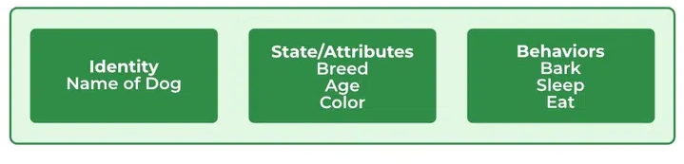
Java Objects
An object in Java is a basic unit of Object-Oriented Programming and represents real-life entities.
Objects are the instances of a class that are created to use the attributes and methods of a class
  State : It is represented by attributes of an object. It also reflects the properties of an object.
  Behavior : It is represented by the methods of an object. It also reflects the response of an object with other objects.
  Identity : It gives a unique name to an object and enables one object to interact with other objects.
Example of an object: dog

Slide 7
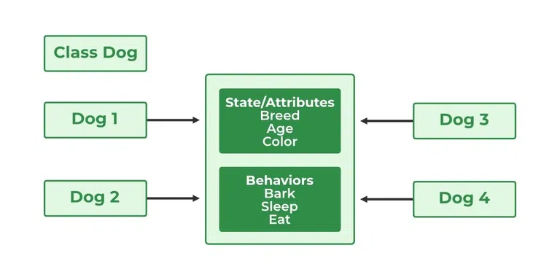
Declaring Objects (Also called instantiating a class)
When an object of a class is created, the class is said to be instantiated . All the instances share the attributes and the behavior of the class. But the values of those attributes, i.e. the state are unique for each object. A single class may have any number of instances.

Slide 8
Initializing a Java object
The new operator instantiates a class by allocating memory for a new object and returning a reference to that memory. The new operator also invokes the class constructor.

Slide 9
Example :1
/**
* dog
*/
public class dog {
// Instance Variables
String name;
String breed;
int age;
String color;
// Constructor Declaration of Class
public dog(String name, String breed, int age,
String color)
{
this.name = name;
this.breed = breed;
this.age = age;
this.color = color;
}
// method 1
public String getName() { return name; }
// method 2
public String getBreed() { return breed; }
// method 3
public int getAge() { return age; }
// method 4
public String getColor() { return color; }
@Override public String toString()
{
return ("Hi my name is " + this.getName()
+ ".\nMy breed,age and color are "
+ this.getBreed() + "," + this.getAge()
+ "," + this.getColor());
}
public static void main(String[] args)
{
dog tuffy
= new dog("tuffy", "papillon", 5, "white");
System.out.println(tuffy.toString());
}
}

Slide 10
Example 2 : Initialize by using method/function
public class GFG {
// sw=software
static String sw_name;
static float sw_price;
static void set(String n, float p)
{
sw_name = n;
sw_price = p;
}
static void get()
{
System.out.println("Software name is: " + sw_name);
System.out.println("Software price is: "
+ sw_price);
}
public static void main(String args[])
{
GFG.set("Visual studio", 0.0f);
GFG.get();
}
}

Slide 11
Ways to Create an Object of a Class
There are four ways to create objects in Java. Strictly speaking, there is only one way(by using a new keyword), and the rest internally use a new keyword.
1. Using new keyword
  // creating object of class Test
  Test t = new Test();

Slide 12
2. There is a pre-defined class in java.lang package with name Class. The forName(String className) method returns the Class object associated with the class with the given string name. We have to give a fully qualified name for a class. On calling the new Instance() method on this Class object returns a new instance of the class with the given string
  // creating object of public class Test
  // consider class Test present in com.p1 package
  Test obj = (Test)Class.forName("com.p1.Test").newInstance();
3. Using clone() method
clone() method is present in the Object class. It creates and returns a copy of the object.
  // creating object of class Test
  Test t1 = new Test();
  // creating clone of above object
  Test t2 = (Test)t1.clone();

Slide 13
4. Deserialization
De-serialization is a technique of reading an object from the saved state in a file
  FileInputStream file = new FileInputStream(filename);
  ObjectInputStream in = new ObjectInputStream(file);
  Object obj = in.readObject();

Slide 14
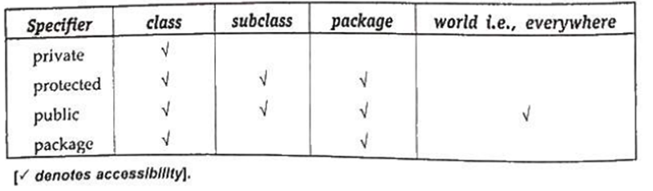
Controlling Access to members of a class - access specifiers
Access specifiers control access to members of a class within a java program.
Private access specifiers denotes a variable or method as being private to the class and may not ve accessed outside the class.
Protected specifier denotes a variable or method as being public to subclass but private to all other classes outside the current package.
All classes within the same package have access to protected variables regardless of whether they are subclasses
Public specifiers denotes a variable or method as being directly accessible from all other classes

Slide 15
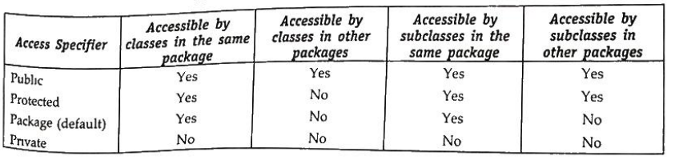
Access Specifier friendly(Default)
The default access specifier is friendly, but it is not a keyword. Friendly means all friends (classes in the same package) can access it.
All these access specifiers are applicable to both the class variables (static variables) and instance variable and also to class methods (static method) and other methods.

Slide 16
Function/Method Definition
In java, a function (or method) must be defined before it is used anywhere in the program. The general form of a function / method definition is as given below
  [access-specifier] [modifier] return-type function-name (parameter list)
  {
  Body of the function
  }

Slide 17
Where
access specifier can be either public or protected or private. These keywords are used to determine the type of access to the function. Default is friendly, which is not a keyword.
modifier can be one of . final, native, synchronized, transient, volatile. A final method means that the functionality defined inside this very method can never be changed.
return_type specifies the type of value that the return statement of the function returns It may be of any valid Java data type. If no value is being returned, it should be void.
Function-name it ahs to be valid java identifier.

